Slide 1
25. java this keyword
S.R.Zameer

Slide 2
this keyword in java
There can be a lot of usage of java this keyword. In java, this is a reference variable that refers to the current object.

Slide 3
Usage of java this keyword
Here is given the 6 usage of java this keyword.
this keyword can be used to refer current class instance variable.
this() can be used to invoke current class constructor.
this keyword can be used to invoke current class method (implicitly)
this can be passed as an argument in the method call.
this can be passed as argument in the constructor call.
this keyword can also be used to return the current class instance.
Suggestion: If you are beginner to java, lookup only two usage of this keyword.

Slide 4
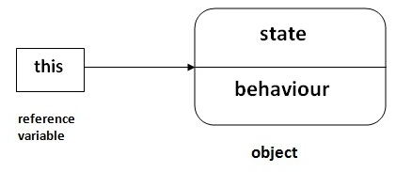
this keyword in java

Slide 5
1) The this keyword can be used to refer current class instance variable.
If there is ambiguity between the instance variable and parameter, this keyword resolves the problem of ambiguity.

Slide 6
2) this() can be used to invoked current class constructor.
The this() constructor call can be used to invoke the current class constructor (constructor chaining). This approach is better if you have many constructors in the class and want to reuse that constructor.

Slide 7
3)The this keyword can be used to invoke current class method (implicitly).
You may invoke the method of the current class by using the this keyword. If you don't use the this keyword, compiler automatically adds this keyword while invoking the method.

Slide 8
4) this keyword can be passed as an argument in the method.
The this keyword can also be passed as an argument in the method. It is mainly used in the event handling.

Slide 9
5) The this keyword can be passed as argument in the constructor call.
We can pass the this keyword in the constructor also. It is useful if we have to use one object in multiple classes.

Slide 10
6) The this keyword can be used to return current class instance.
We can return the this keyword as an statement from the method. In such case, return type of the method must be the class type (non-primitive).

Slide 11
Syntax of this that can be returned as a statement
return_type method_name()
{
return this;
}

